Slide 1
HudsonAlpha BioTrain Computational Bootcamp

Slide 2
Computer Setup
https://james-lawlor.github.io/biotrain-2022/
Setup Bash
(Windows) Download Git BASH http://www.gitforwindows.org
(Mac/Linux) Included. Open the “Terminal” application.
Get data-shell.zip from SW Carpentry http://swcarpentry.github.io/shell-novice/setup.html
Install R https://cran.rstudio.com/
Install RStudio Desktop https://www.rstudio.com/products/rstudio/download/#download
Download r-novice-inflammation data

Slide 3
Wednesday Agenda
What is Computational Biology?
Computational Biology Examples in the Myers Lab
Bootcamp Intro
Goals
Helpers & Post-Its
Why learn Unix & R?
Programming with R
Analyzing Biology Data
Writing Functions
Using For Loops to Analyze Multiple Data Sets
Getting Programming Help

Slide 4
Thursday Agenda
Computational Biology in the Cooper Lab
Keeping a Computational Lab Notebook
Unix Fundamentals
Introducing the Shell
Navigating Files and Directories
Working With Files and Directories
Pipes, Filters, and Loops (brief overview of advanced topics)
Continued Learning: Where to go next?

Slide 5
Introduction to Biology with Computers
James Lawlor & Belle Moyers

Slide 6
What is computational biology?
“Computational biology and bioinformatics is an interdisciplinary field that develops and applies computational methods to analyze large collections of biological data, such as genetic sequences, cell populations or protein samples, to make new predictions or discover new biology.” -- Nature.com

Slide 7
In other words…
Use computational tools
Programming
Mathematical models & machine learning
Databases
Physics simulations
To analyze huge sets of data
Genome sequencing
Protein modeling
And answer biological questions
How does this gene work?
Does this disease have a genetic pattern?
How are these species related?
What makes a liver cell different from a brain cell?

Slide 8
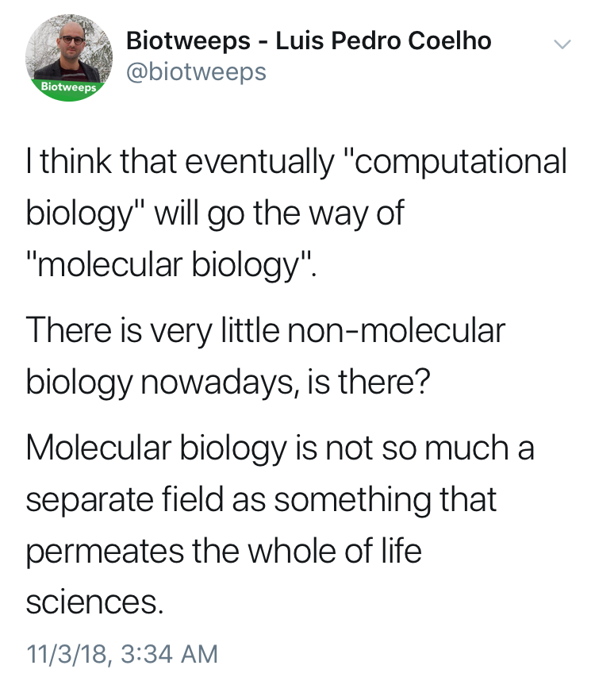

Slide 9
Terminology
The terms “bioinformatics” and “computational biology” are often used interchangeably:
Bioinformatics: Software tools, databases, visualization methods
Computational Biology: Data analysis, algorithm development, mathematical modeling
Other terms for the intersection of biology / math / computer science:
Data Science, Systems Biology, Statistical Biology, Biostatistics, Genomics (implicit), _____omics, Clinical Informatics, etc…

Slide 10
The bottom line:
Computational skills are increasingly critical for biology & many other fields
Hands-on experience is a huge first step

Slide 11
Belle’s intro to comp bio

Slide 12


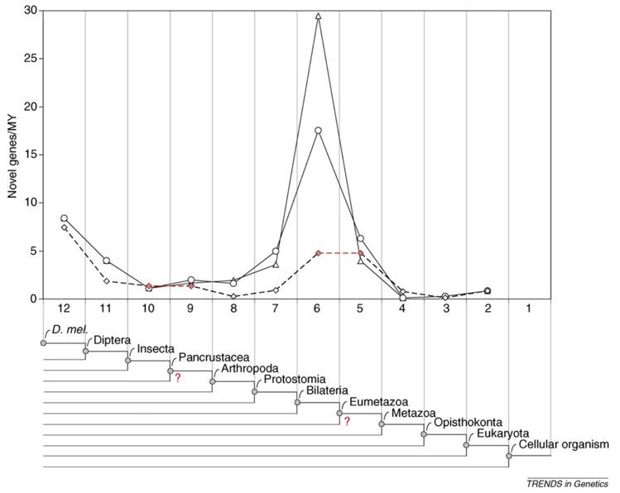

About Belle Moyers
B.S. Biological Sciences, B.A. Psychology, Purdue University
PhD Bioinformatics, M.A. Applied Statistics, University of Michigan
Graduate thesis: On Gene Age, Gene Origins, and Evolutionary Trends

Slide 13
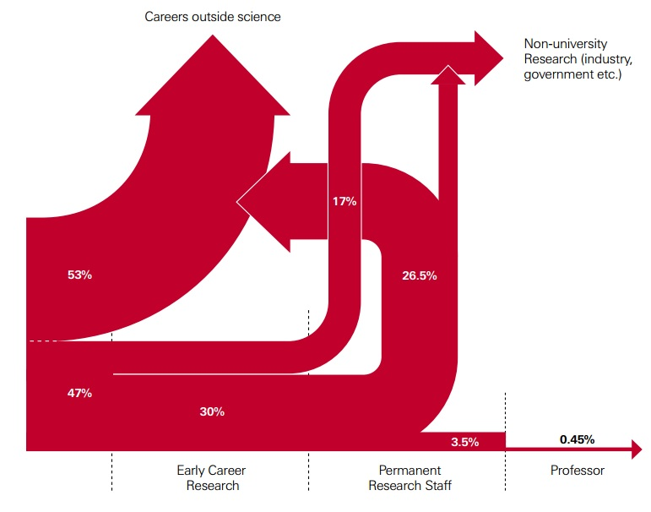
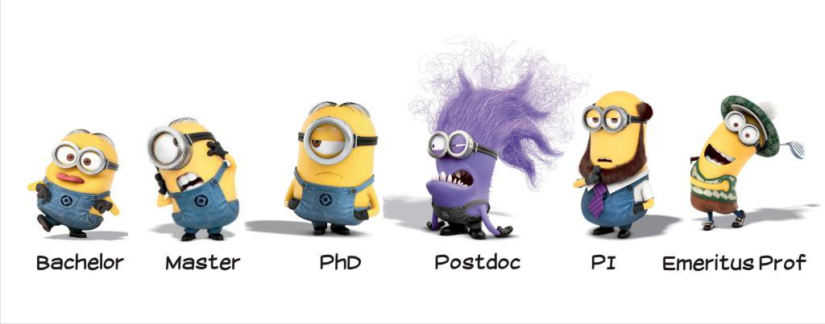
Postdoctoral Fellow and Beyond
HudsonAlpha Institute for Biotechnology, 2017-Present
Computational and Statistical analysis of genomic data for gene regulation.
Analysis of genomic variants in disease.
http://blogs.nature.com/naturejobs/2014/10/03/the-postdoc-decision/

Slide 14
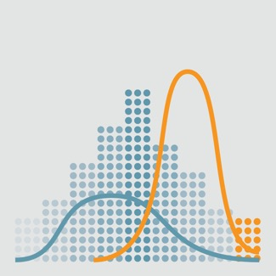
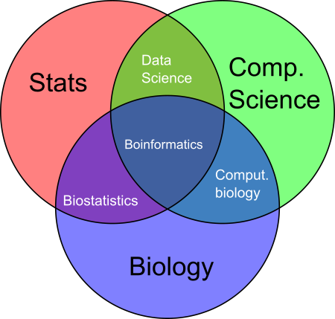
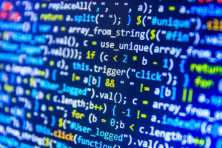
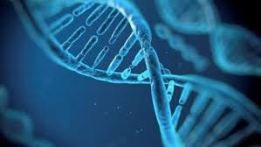
What is Bioinformatics?
“The science of collecting and analyzing complex biological data such as genetic codes.”
Day-to-day, bioinformatics is mostly coding, statistical analysis of biological data, and data visualization.
Work with biological data and other biologists to:
1) form conclusions
2) make new predictions / hypotheses to be tested
3) code computational tools for the biological community.

Slide 15
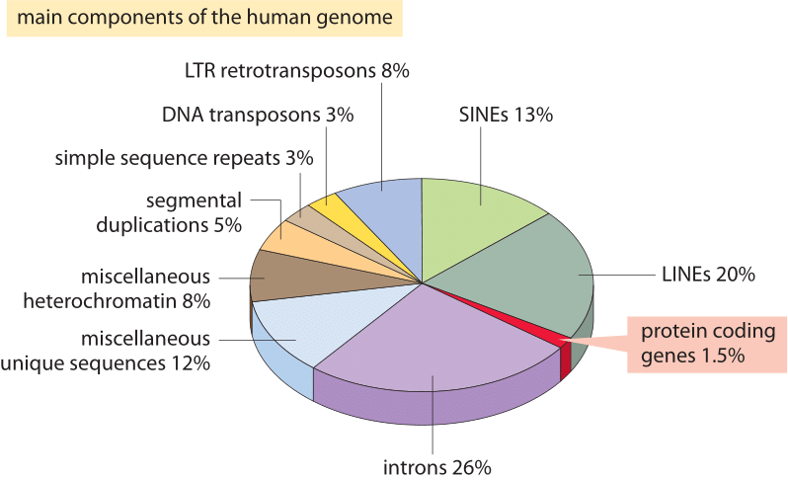
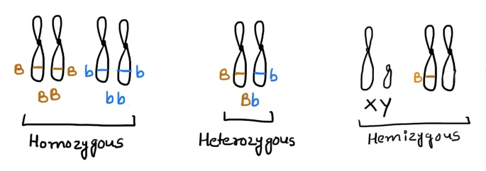
Why Bioinformatics?
Let’s take a look at a single human genome…
~3 billion nucleotides. Two copies– mostly identical.
~22,000 protein-coding genes. ~1.5% of the genome (45 million nucleotides).
The remaining ~98.5% controls gene regulation, genome shape, chromatin, etc.

Slide 16
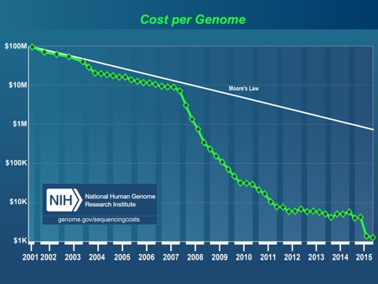

Why Bioinformatics?
The cost of sequencing has rapidly decreased over the past decade, hitting the “$1000 genome.”
The NIH “All of us” Initiative has made it a goal to sequence 1 million genomes, each with ~3 billion nucleotides. (recently released the first 100k genomes)
Sequencing of more individuals can help humanity in several ways.
Better understanding of disease causes and risks.
Better understanding of diversity and responses to medicine.
A genetic window into human history– when various populations migrated to different areas and/or re-integrated.

Slide 17
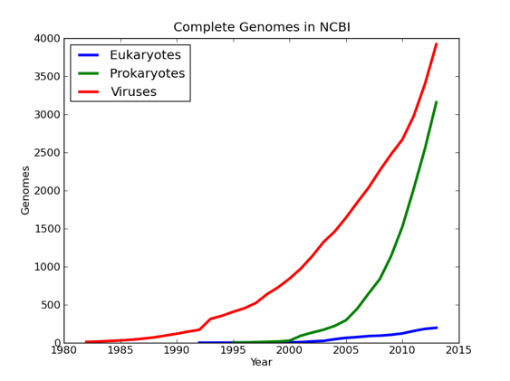
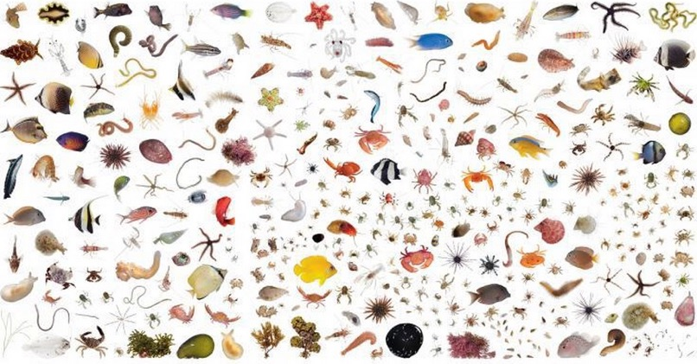
Why Bioinformatics?
~10,000 different species have sequenced genomes.
But there are an estimated 8.7 million species on the planet
Better understanding of molecular evolution
Potential sources of medicine
Implications for conservation efforts
Better understanding of what genetic elements can help species to survive in difficult environments.

Slide 18

Why Bioinformatics?
These problems can’t be solved by hand. Computational approaches are necessary to analyze enormous amounts of biological data.
There are ethical and social areas that intersect with bioinformatics
if ( action != ethical ) {
print(“Don’t do that!”)
}

Slide 19
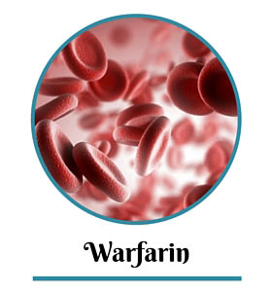
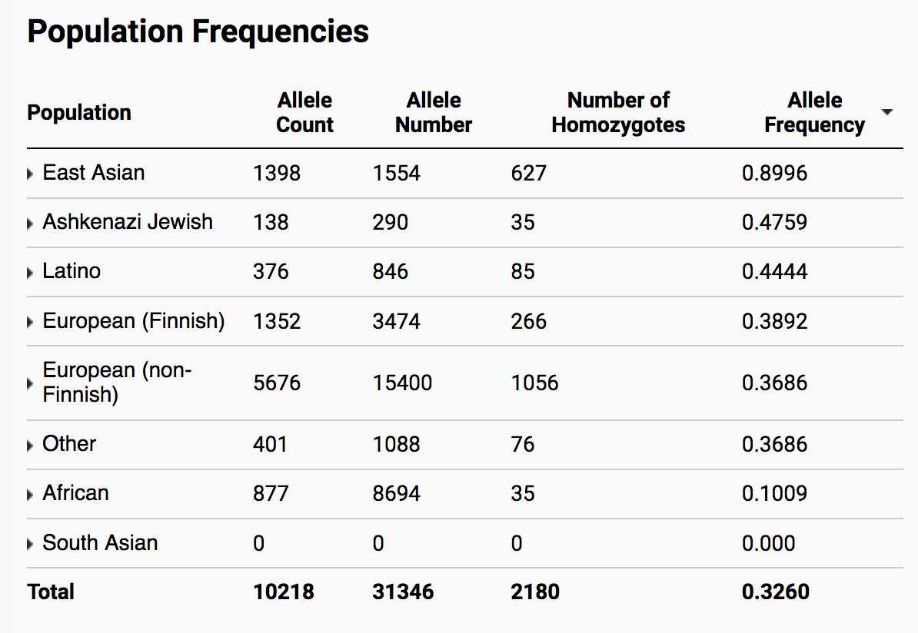
Representation – serving a broader community
For a particular medical finding, how sure can we be that the results are true across different populations? Men and women? Various racial and ethnic groups?
Different genetic background can have implications for the effects of medicine, symptoms of disease.
It’s possible that a variant that is rare in one population is very common in another.

Slide 20
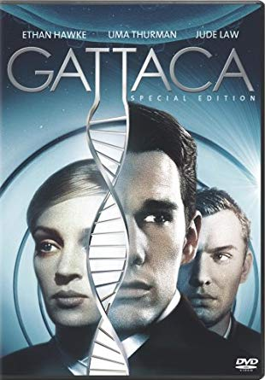


Protection – once the data exists, how do we keep it safe?
How can we protect a person’s genetic data?
Who should have access to a person’s genetic data, and how can we help ensure that only those people have access?
Should genetic and medical data be available for research? How can we de-identify information to protect people?

Slide 21
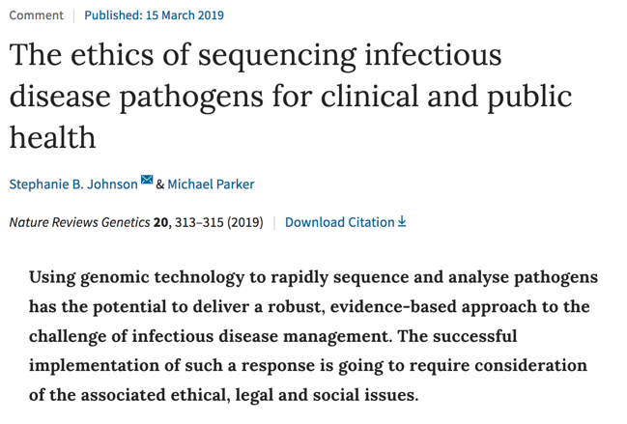
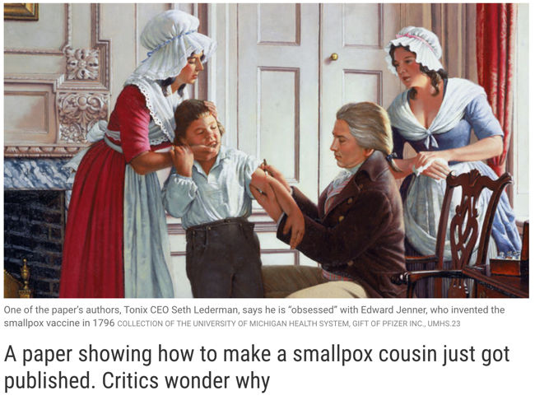
Public Safety – how do we protect and use data to keep people safe?
Should we restrict public access to the genome sequences of dangerous organisms?
If so, how can data be stored to both protect the public and still allow research to be performed?

Slide 22
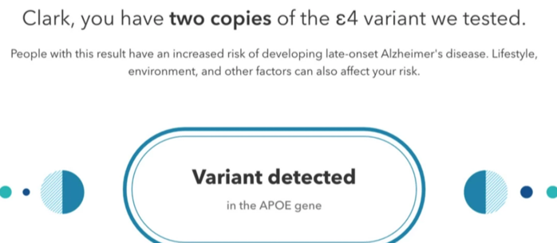
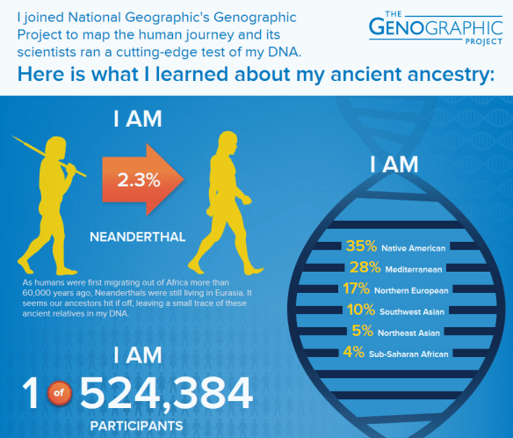
Use and Presentation of Data – how can we avoid misrepresentation and misuse?
How can we avoid misleading patients or doctors about the interpretation of bioinformatics results?
Disease risk?
Accuracy/interpretation of ancestry estimates?
Misappropriation of scientific findings: https://twitter.com/JedMSP/status/1526985711282446337

Slide 23
Comp bio in the Myers lab

Slide 24
What do I do?
Genetic Variation
Change in TF-DNA associations
Change in Gene Expression
Disease
eQTLs
Gene- or genome-wide association

Slide 25
Gene Regulation

Slide 26
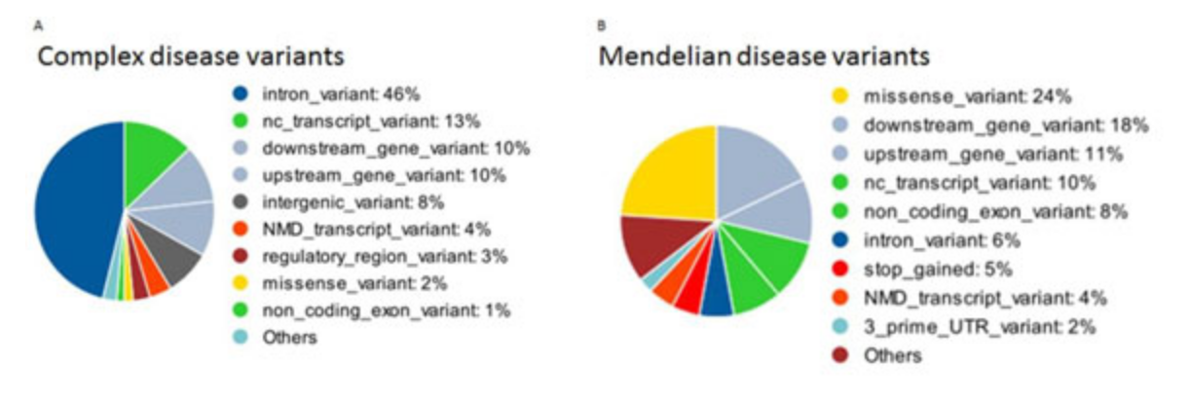
Disease variants outside of the protein-coding region
The “easiest” (still very difficult) disease variants to understand are those that occur in the protein-coding region of a gene.
But plenty of disease-associated variants do not occur in the protein-coding region.
6%
29%
https://www.ncbi.nlm.nih.gov/pmc/articles/PMC4480828/

Slide 27
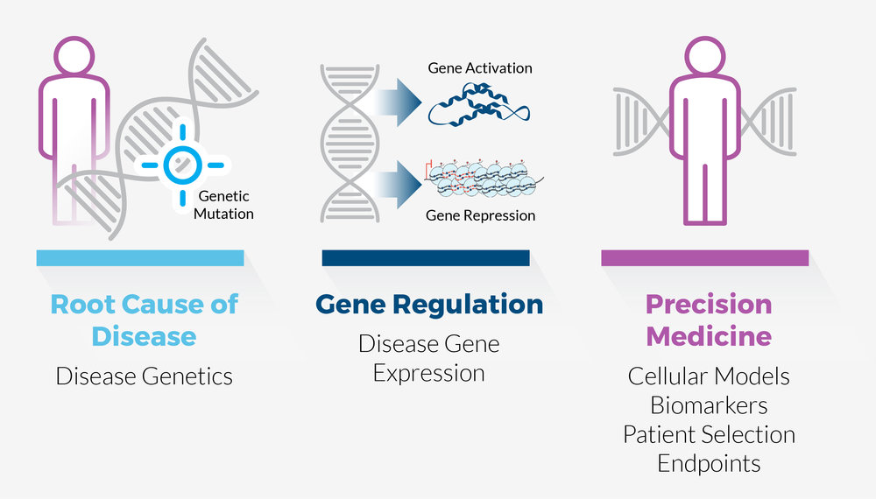
Disease often involves change in gene expression
Understanding how gene expression is regulated and changed can lead to novel insights about disease.

Slide 28
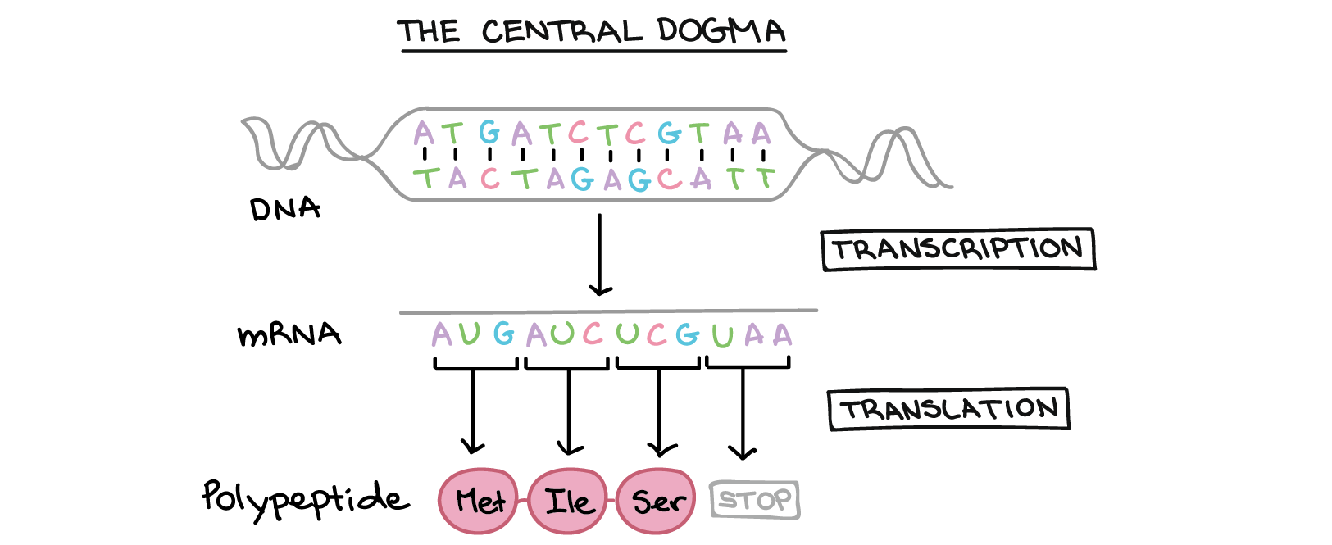
Transcription Factor Binding
The ”central dogma” of molecular biology shows the derivation of RNA from DNA and Protein from RNA.

Slide 29
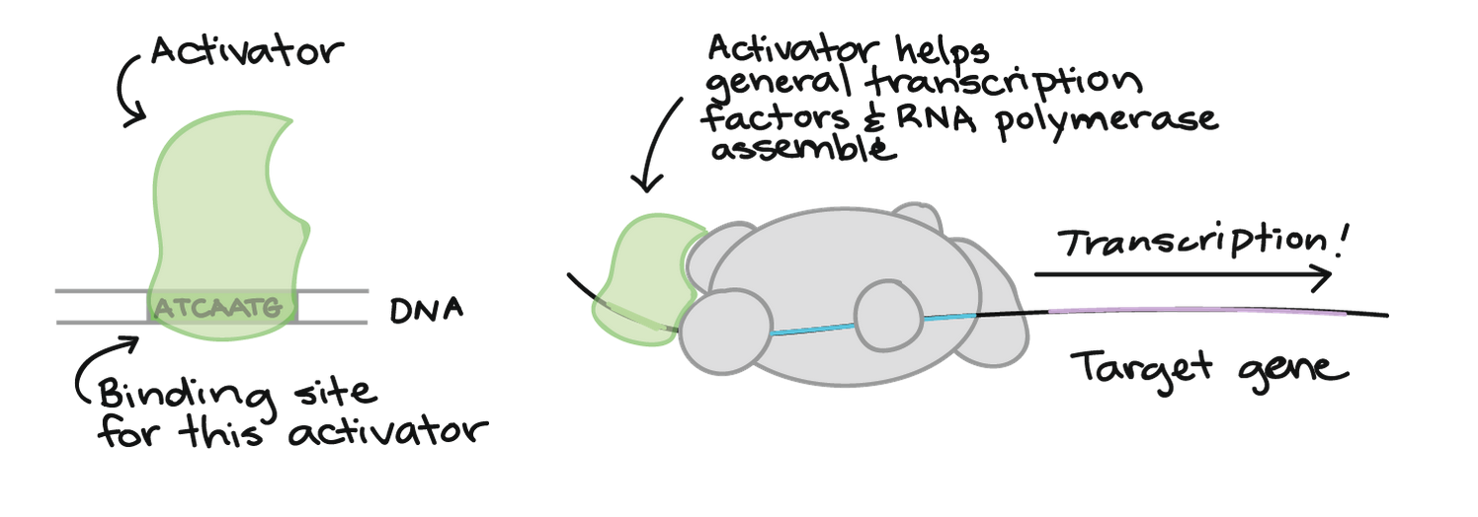
Transcription Factor Binding
For RNA to be produced from DNA, you need activating Transcription Factors (TFs) to bind to DNA.

Slide 30
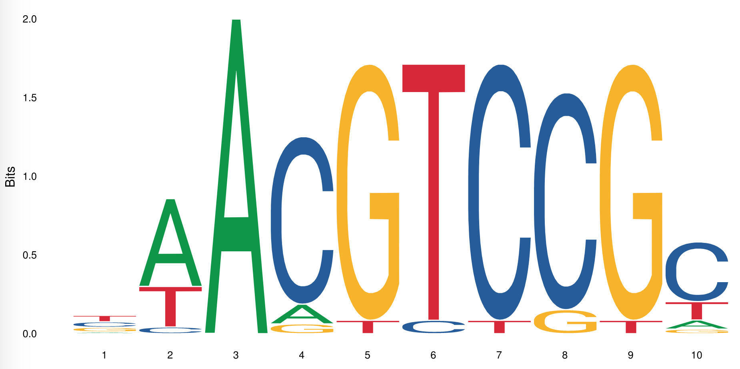
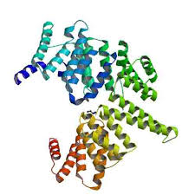
What makes TFs bind?
What makes a TF bind to some places in DNA but not other places?
Many TFs bind specific DNA sequences, which can be represented by DNA sequence motifs.
If this motif sequence is destroyed with a mutation, it may stop a TF from binding DNA

Slide 31
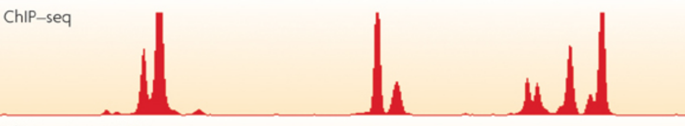
But *which* mutations?
There are an astronomical number of mutations that are possible in the genome!
How do we know which ones actually influence TF binding? How do we narrow it down?
First we identify which parts of the genome are bound by a given transcription factor: ChIP-seq.

Slide 32
Investigating regulatory sequences
Given the locations of bound TFs, what can you do with that information?
Models of TF binding
Identifying allele-biased binding
Identifying effects of binding

Slide 33
Models of TF binding

Slide 34
Models of TF binding
We can compare bound sequences to unbound sequences and look for differences.
Can you determine any patterns from the data below?
>BoundSequence1
AAAAAAACGA
>BoundSequence2
AAAATAAAAA
>BoundSequence3
AAAAAAACAA
>BoundSequence4
AATAAAAAAG
…
>UnboundSequence1
GGGGGGGGGG
>UnoundSequence2
AAAAGAAAAA
>UnoundSequence3
AGAAGGATAG
>UnoundSequence4
TTAGGATTGAT
…

Slide 35
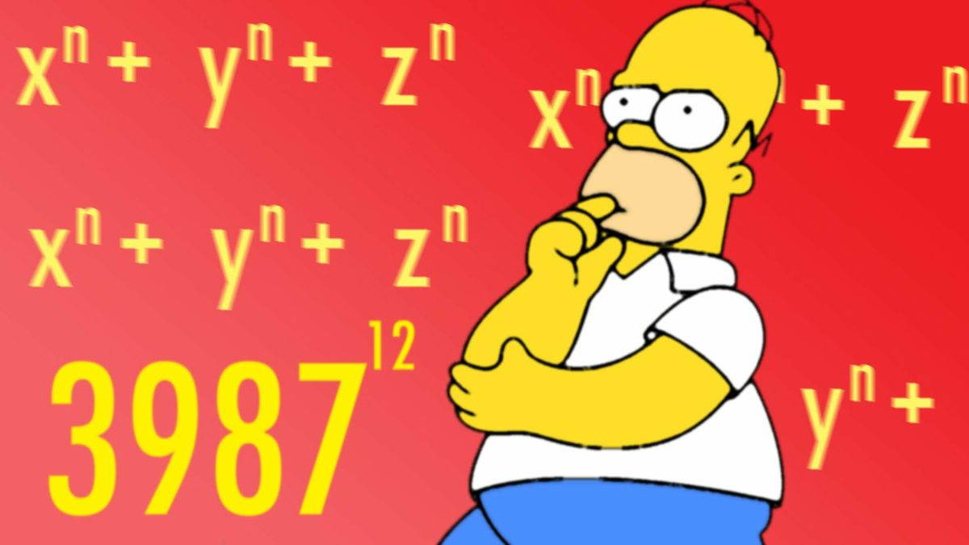
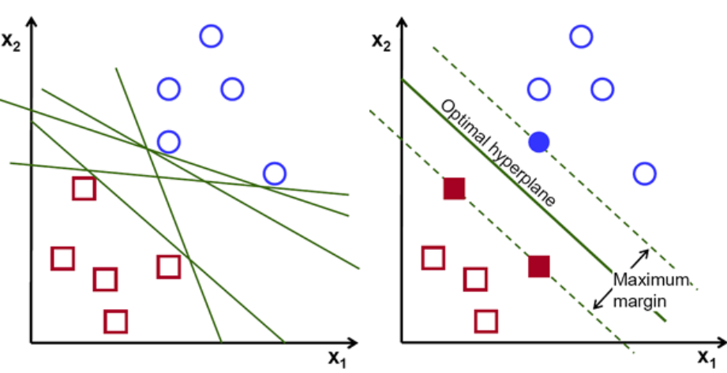
Don’t do it manually– Use Bioinformatics!
Of course, visually inspecting sequences is unlikely to detect real patterns. And if it does, it’s extremely time-consuming!
Instead, we use math!
From input data, we can create a model called a support vector machine.
Bound Sequences
Unbound Sequences
Input Data
MATH!
Models of TF binding

Slide 36
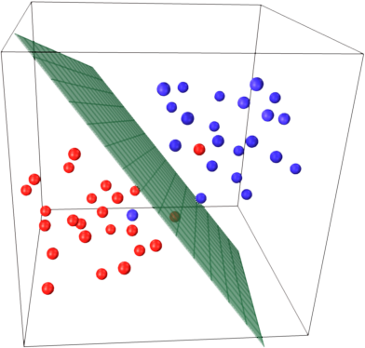
Using this model
This mathematical model can then be used to compare new sequences and determine how likely it is a TF would bind them.
This is one way of determining how a regulatory variant might impact TF binding. This, specifically, is a Support Vector Machine (SVM).
Bound Sequences
Do these two sequences fall on different sides of the dividing line?
>NativeSequence
GATTACA
>MutantSequence
CATTACA
Unbound sequences

Slide 37
Sequence representation models
In an SVM, sequence is projected into multi-dimensional space in an attempt to separate bound and unbound sequences.
There are other models which are more interpretable visually, including motif-finding algorithms and sequence-based neural networks.

Slide 38
Allele-biased binding

Slide 39
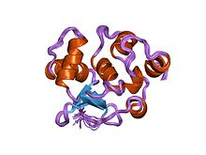
Allele-biased binding and Reference Allele Bias
In-vivo binding
ChIP-seq reads
Reference mapping
Mapping to donor genome
Binomial p-value: 2.5E-7
Binomial p-value: 0.83
 | Ref. Reads | Alt. Reads | Pvalue
Example1 | 30 | 2 | 2.5E-7
Example2 | 10 | 12 | 0.83

Slide 40
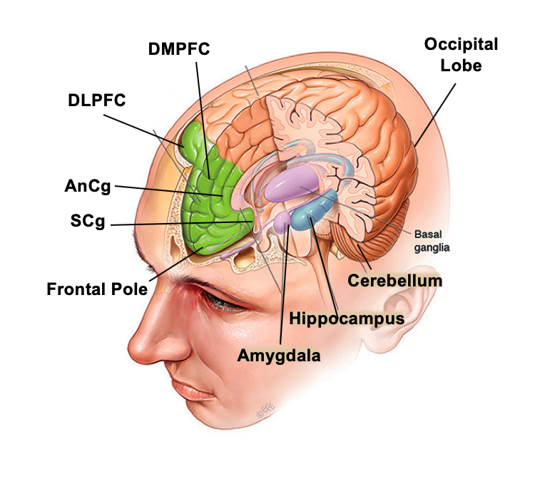
Data Sources and results
Two people who donated their body to science.
~960 ChIP-seq experiments in different human brain regions.
 | Donor1 (% vars) | Donor2 (% vars)
Number of variants impacting binding | 146,383 (4.82657%) | 155,962 (5.073138%)
Total Var*TF interactions | 320,368 | 354,117
Mean TFs/variant | 2.18856 | 2.270534

Slide 41
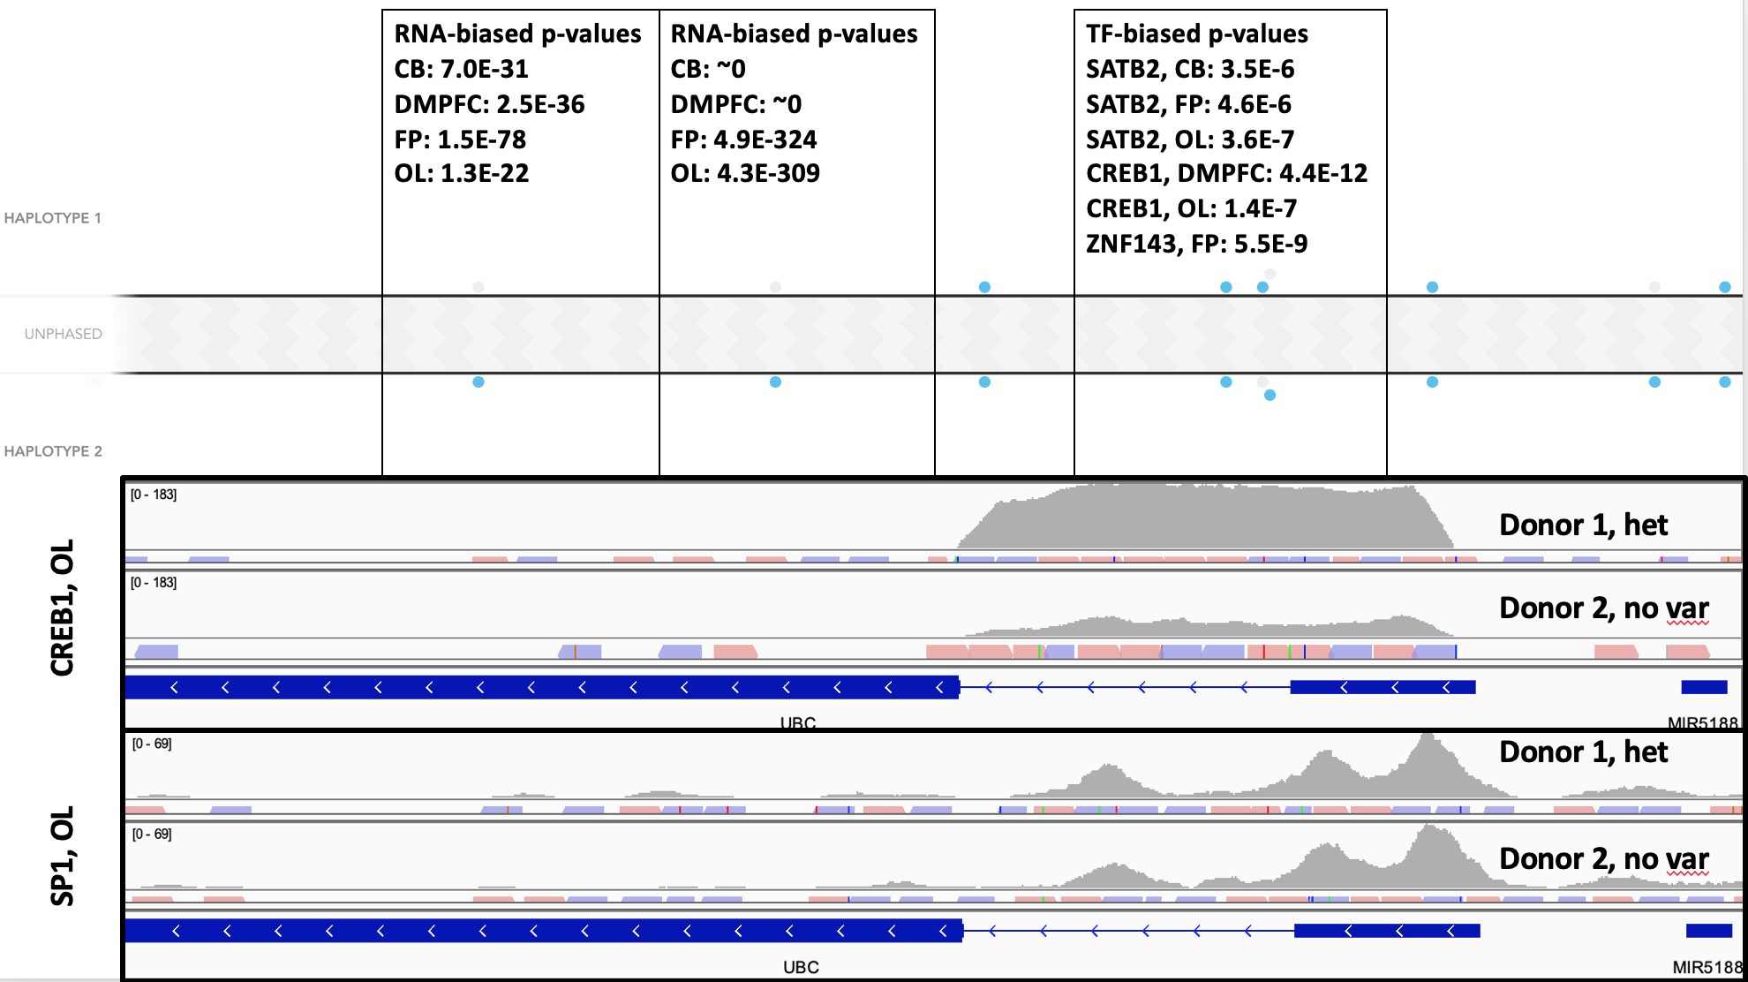
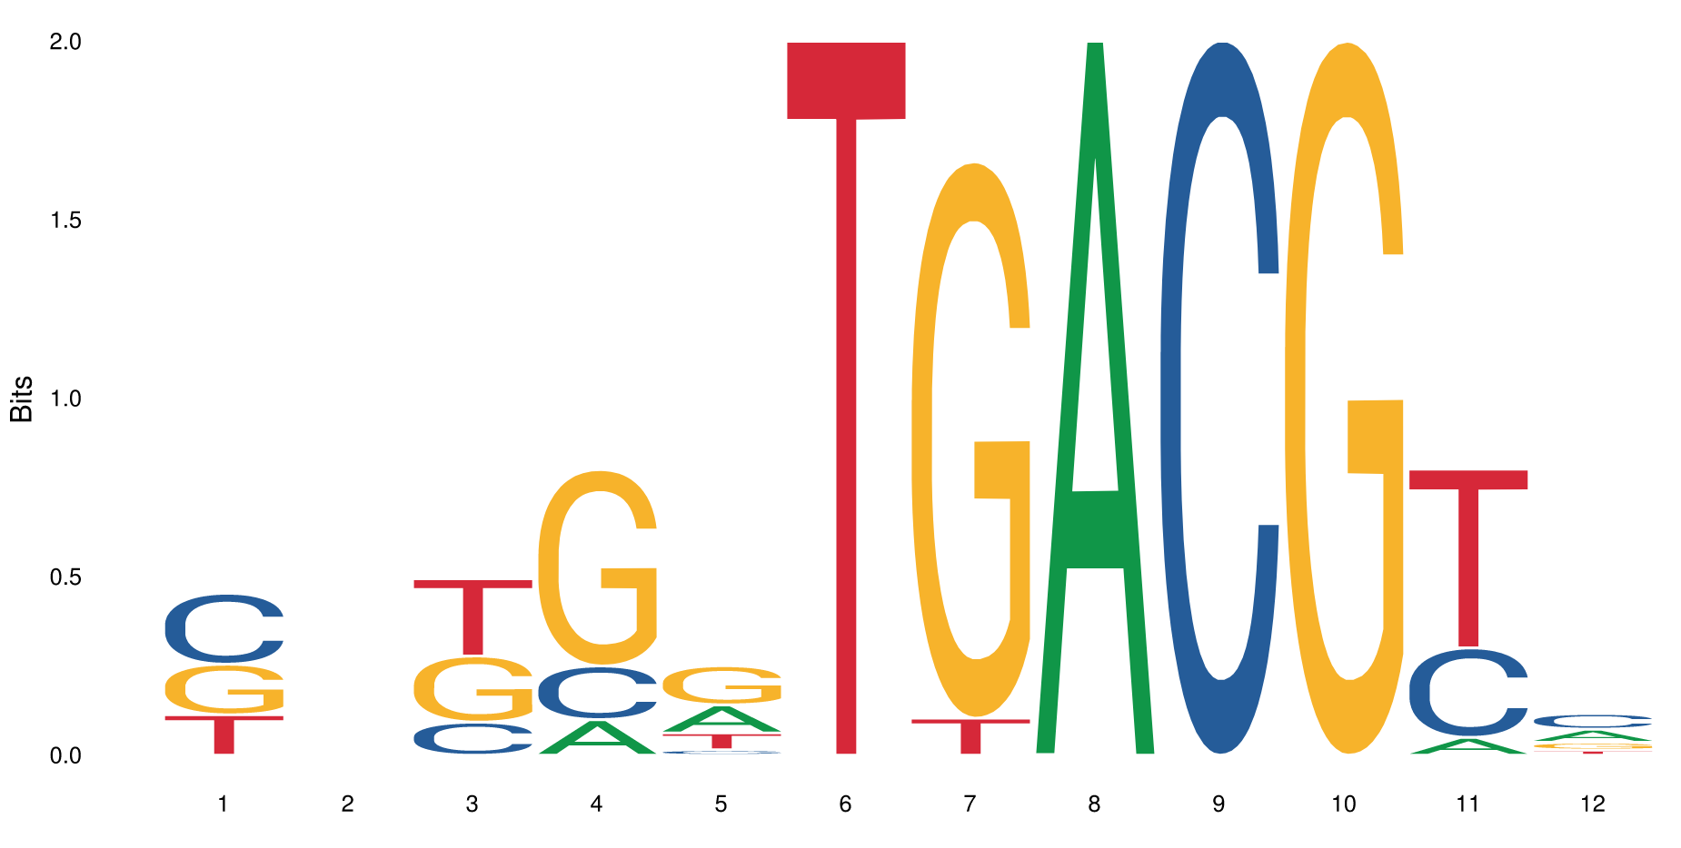
Impacting Expression
GTTCTTGACGCTG
GTTCTTGGCGCTG

Slide 42
Effects of binding: Gene-expression relationship

Slide 43
Transcription Factor Binding
For RNA to be produced from DNA, you need activating Transcription Factors (TFs) to bind to DNA.

Slide 44
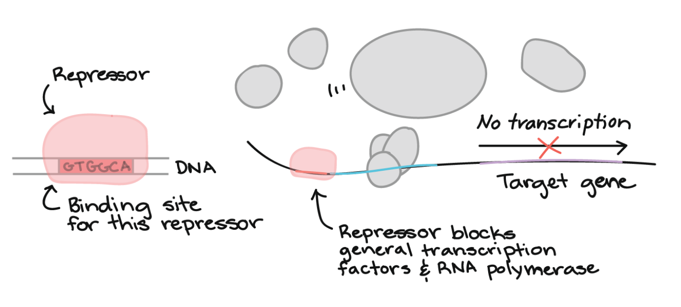
Transcription Factor Binding
There are activators *and* repressors.
Each TF might have a different function, and a different strength, depending on the context.

Slide 45
Teasing out TF effects from biological data
Ideally, we could test each TF individually.
In practice, this is very difficult.
But we have biological data from gene promoters that tells us expression level and all the TFs bound.

Slide 46
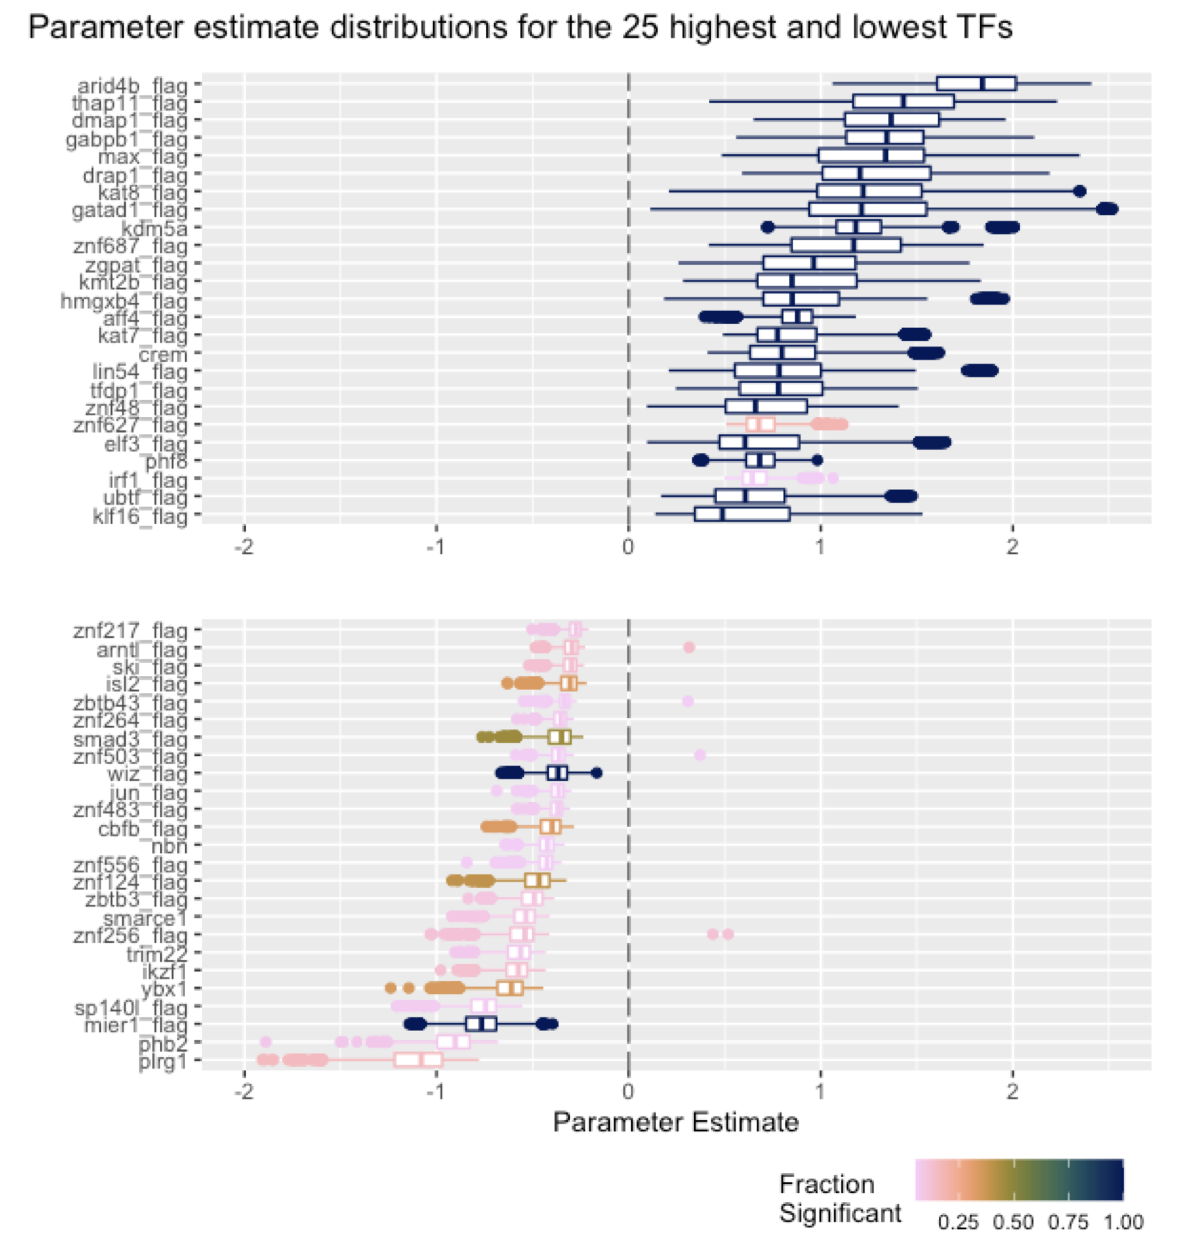
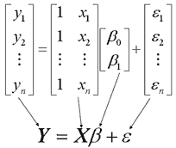
What is the function of a particular TF binding?
It can be very difficult to figure out the function of an individual TF.
There are 1600+ TFs, and their behavior can be context-dependent!
We can use linear modeling to generate hypotheses to TF function.
In more complicated models, we can compare these estimates across cell types, looking at differential binding between one cell type and another and differential expression to identify TF function.

Slide 47
Summary
My research focuses on understanding non-coding DNA.
I focus on how TFs bind to DNA to affect gene transcription.
I use direct observations and machine learning to understand binding and its effects.
I have additional work that involves representing genomes in different ways, but we don’t have time to discuss that.

Slide 48
Bootcamp Intro

Slide 49
Goals
Introduce computational biology through:
Discussion of real-world need for computational skills in genomics
Hands-on lessons from the Software Carpentry in R & Unix Shell
After today, we will be able to:
Read and manipulate data in the R programming language
Use programming concepts in R: Functions and For Loops *
After tomorrow we will be able to:
Navigate files and folders on a Unix system
Create, copy, move, delete, and find files and folders
Record work in a computational lab notebook
Know where to learn more and how to ask for help

Slide 50
Flow
Discuss concepts -> work exercises -> review together
Website has links to reading/example material: http://james-lawlor.github.io/biotrain-2022
Asking questions = better experience for everyone
Live feedback with post-its:
Green post-it on computer: The pace is good and I’m keeping up
Red post-it on computer: I’d like a helper / Slow down!
Helpers: Experienced helpers are available for one-on-one help as we’re working

Slide 51
Why learn Unix and R?
Unix lets us access high-performance computing environments and industry-standard software
Easy way to introduce fundamental concepts about programming and computers:
Let the computer do the work for you instead of repeating yourself
Save your “program” so you can re-use it later
Learn to combine small tools into a more complex behavior
Learn to troubleshoot problems (of any kind)
A little hands-on experience goes a long way

Slide 52
~ 10 minute Break

